Slide 1






JavaScript
Team Cymbidium Orchid
Teamwork Project
Software University
http://nakman.spirtuni.cloudvps.bg

Slide 2

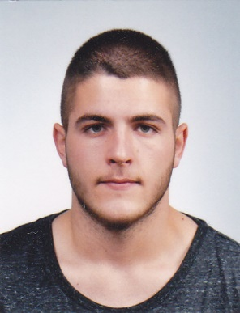
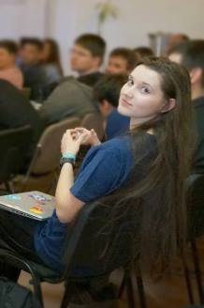
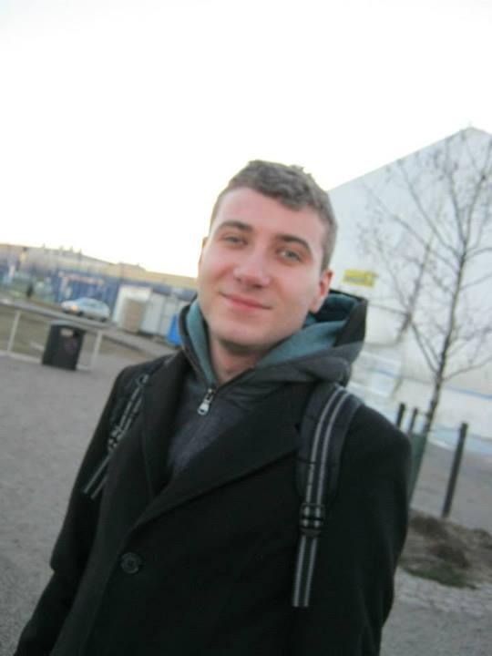
Team Cymbidium Orchid
Georgi Inkov
Daniel
Petrovaliev
Yulia
Tenincheva
Ivan
Yonkov

Slide 3
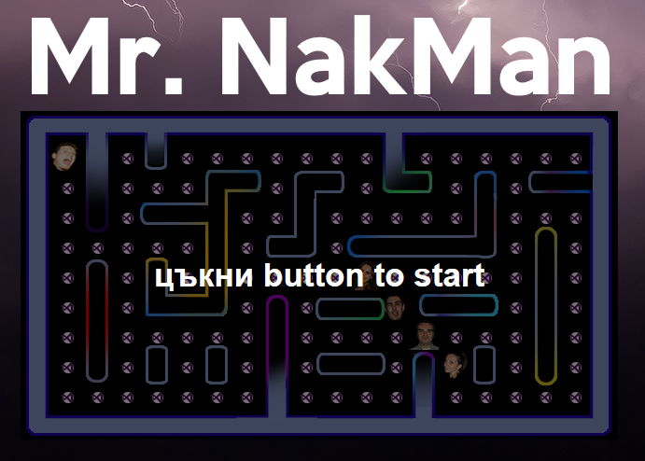

http://nakman.spirtuni.cloudvps.bg
Demo…
Demo…
https://github.com/CymbidiumOrchid/NakMan

